Slide 1
Agreement Analysis Tool with R
Amrita Anam
Brandon Gallas
Weijie Chen
Zhiwei Zhang

Slide 2
Motivation
Develop a method and a tool
Calculate and evaluate reader agreement in multi-reader multi-case(MRMC) studies
Compare pathologists’ performance over different imaging modalities

Slide 3
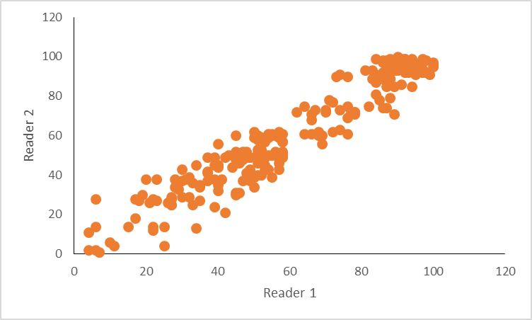
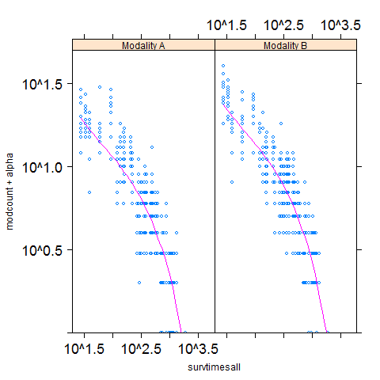

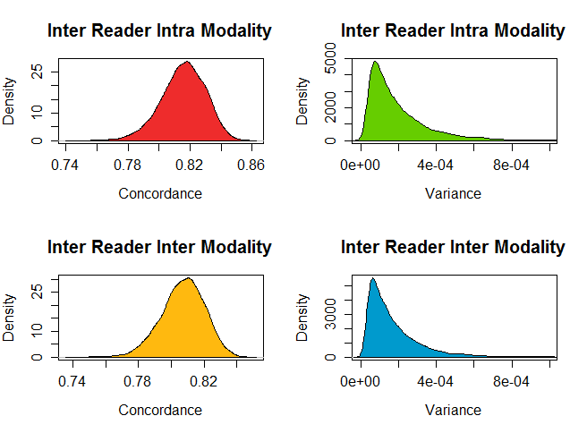
Overview
Reader Agreement
Mitotic Count Simulation
Tool Development
Validation
Concordance
Process Overview
Development Team
Example
Intra and Inter Reader
Detailed Work Flow
Tool Access
Results
Methodology
Inputs and Outputs
Application

Slide 4
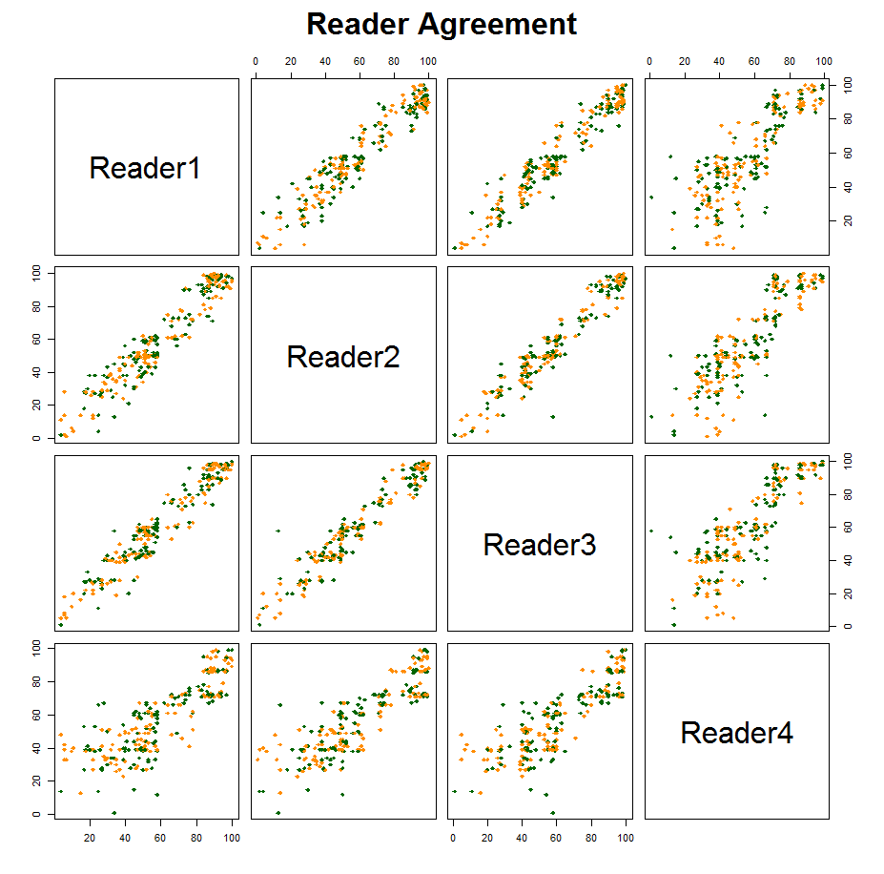
Reader Agreement
A measure of agreement
between 2 readers
reading a set of cases
over the same modality

Slide 5
Reader Agreement – Concordance
Given reading conditions: A and B
cases: 1 and 2
scores: A1, A2, B1 and B2
Ranking Outcome | Description | Example
Tie in both | scores tied in both conditions | A1 = A2, B1 = B2
Tie in A | scores tied in condition A only | A1 = A2, B1 ≠ B2
Tie in B | scores tied in condition B only | A1 ≠ A2, B1 = B2
Concordance | score for condition A are in the same order as score for condition B | A1 > A2 , B1 > B2
Discordance | scores for condition A are in the opposite order as s for condition B | A1 > A2 , B1 < B2

Slide 6
Reader Agreement: Concordance
Given
reading conditions: A and B
cases: 1 and 2
scores: A1, A2, B1 and B2
Ranking Outcome | Example
Tie in both | A1 = A2, B1 = B2
Tie in A | A1 = A2, B1 ≠ B2
Tie in B | A1 ≠ A2, B1 = B2
Concordance | A1 > A2 , B1 > B2
Discordance | A1 > A2 , B1 < B2

Slide 7
Reader Agreement
Intra Reader Agreement
Inter Reader Agreement
Intra Modality Agreement
Intra Modality Agreement
Needs Replication
Inter Modality Agreement
Inter Modality Agreement

Slide 8
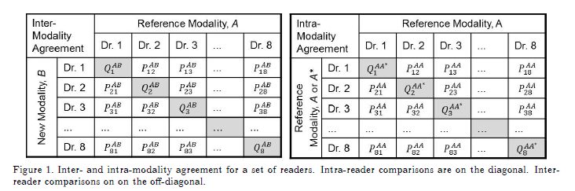
Reader Agreement
Intra Reader Agreement
Inter Reader Agreement
Notes:
Averaging in different areas
MRMC analysis: account for variability from readers and cases

Slide 9
Application: HER-2 Study
Marios’ study to analyze the impact of CAD on HER-2 evaluation [1][2]
Readers | 14 (7 pathologists, 7 novices)
Cases | Study 1 – 241 in both modalities (no replication) Study 2 – 47 in both modalities (with replication)
Modalities | Unaided, Aided with CAD
Study Design | Fully Crossed (Every reader reads every case in both modalities)
[1] Gavrielides, Marios A., et al. "Observer performance in the use of digital and optical microscopy for the interpretation of tissue-based biomarkers."Analytical Cellular Pathology 2014 (2014).
[2]Lenz, Petra, and Stephen M. Hewitt. "Observer variability in the interpretation of HER2/neu immunohistochemical expression with unaided and computer-aided digital microscopy." Archives of pathology & laboratory medicine 135.2 (2011): 233.

Slide 10
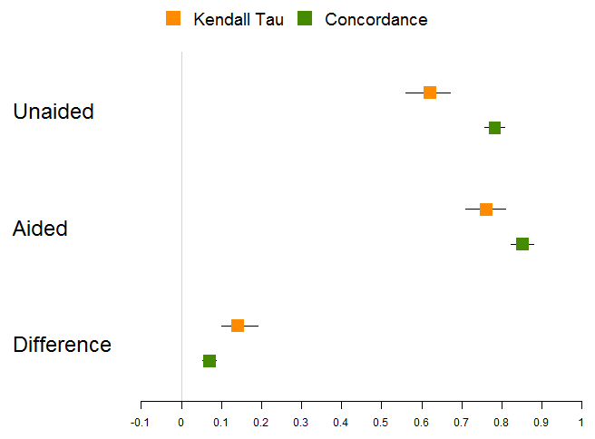
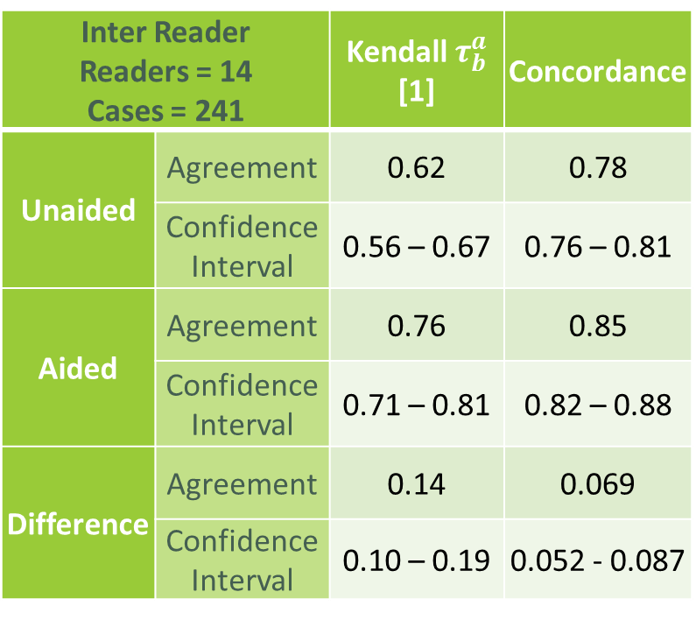
HER-2 Study: Reader Agreement
Inter Reader Readers = 14 Cases = 241 |  | Kendall $τ_{b}^{a}$ [1] | Concordance
Unaided | Agreement | 0.62 | 0.78
 | Confidence Interval | 0.56 – 0.67 | 0.76 – 0.81
Aided | Agreement | 0.76 | 0.85
 | Confidence Interval | 0.71 – 0.81 | 0.82 – 0.88
Difference | Agreement | 0.14 | 0.069
 | Confidence Interval | 0.10 – 0.19 | 0.052 - 0.087
[1]Lenz, Petra, and Stephen M. Hewitt. "Observer variability in the interpretation of HER2/neu immunohistochemical expression with unaided and computer-aided digital microscopy." Archives of pathology & laboratory medicine 135.2 (2011): 233.

Slide 11
Method Development
U-statistics are used to estimate agreement and its variance
Simulation is used to validate variance estimates
Explore different experiment sizes
Explore different simulation configurations
Explore different relative weights of noises
Methods treat fully-crossed data and split-plot studies

Slide 12
Mitotic Count Simulation
Set input parameters (size and model)
Simulate survival time and censoring time
Determine Mean Mitotic Count
Simulate Random Effects: Readers, Cases, Locations (Replicates)
Calculate Agreement Measure and Estimate the variance
Repeat process for all MC trials

Slide 13
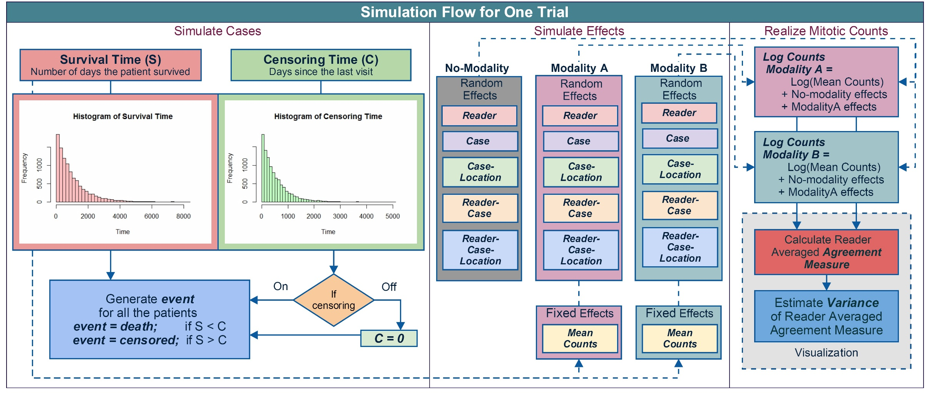
Mitotic Count Simulation: Work Flow

Slide 14
Tool Development: GitHub
Development Team
Mitotic Count Simulation – Amrita
Intra Reader Agreement – Weijie
Inter Reader Agreement – Brandon
Reader Truth Agreement – Zhiwei
Validation and Integration – Amrita

Slide 15
Tool Development
Software Specification
Language : R (can be installed from https://cran.r-project.org/)
Supported OS : windows/mac/linux
Access : GitHub
Application : https://github.com/DIDSR/mitoticCountSimulation/releases
Source Code : https://github.com/DIDSR/mitoticCountSimulation/tree/master
Software Manual: http://didsr.github.io/mitoticCountSimulation/

Slide 16
Tool Development: Simulation and Agreement
Controls:
Study Design
Fully Crossed
Split Plot
Replication
Study Size
Simulation Configuration
No Replication
Replication
Fully Crossed
Split Plot

Slide 17
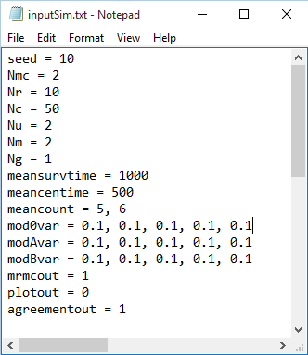
Tool Development: Mitotic Count Simulation
Input
Accept input from a file
Contains 16 parameters
Description is given in the sample input file

Slide 18
Tool Development - Input Components
Random Number Generator
Study Size and Design for Simulation
Means for Truth Simulation
seed = integer to initiate RNG
Nr = Number of readers
Nc = Number of cases
Nu = Number of units/locations
Nm = Number of modalities (tests)
Ng = Number of groups for Split plot
meansurvtime = mean survival time
Nmc = Number of Monte Carlo Simulations to be generated
meancentime = mean censoring time
Output Flags (0/1)
mod0var, modAvar, modBvar = Effects with and without modality
reader-unit/location (within a case) effect
reader-case effect
unit/location (within a case) effect
case effect
mrmcout = save simulation outputs
plotout = save Survival time Vs. Mitotic Counts for one MC trial
meancounts = fixed effect for each modality
Random Effects
Fixed Effects
agreementout = save agreement measures
reader effect

Slide 19
Tool Development - Output
MRMC Output
plotout
Count VS. Survival Time
agreementout
Agreement Measures
mrmcout

Slide 20
Example Study: Simulation Inputs
seed = 10
Nmc = 10000
Nr = 12
Nc = 120
Nu = 2
Nm = 2
Ng = 3
meansurvtime = 1000
meancentime = 500
meancount = 5, 6
mod0var = 0.1, 0.1, 0.1, 0.1, 0.1
modAvar = 0.1, 0.1, 0.1, 0.1, 0.1
modBvar = 0.1, 0.1, 0.1, 0.1, 0.1

Slide 21
First Validation Experiment
Fully Crossed
Split Plot
Cases = 120
Cases = 40
Readers = 4
Readers = 12
Groups = 3

Slide 22
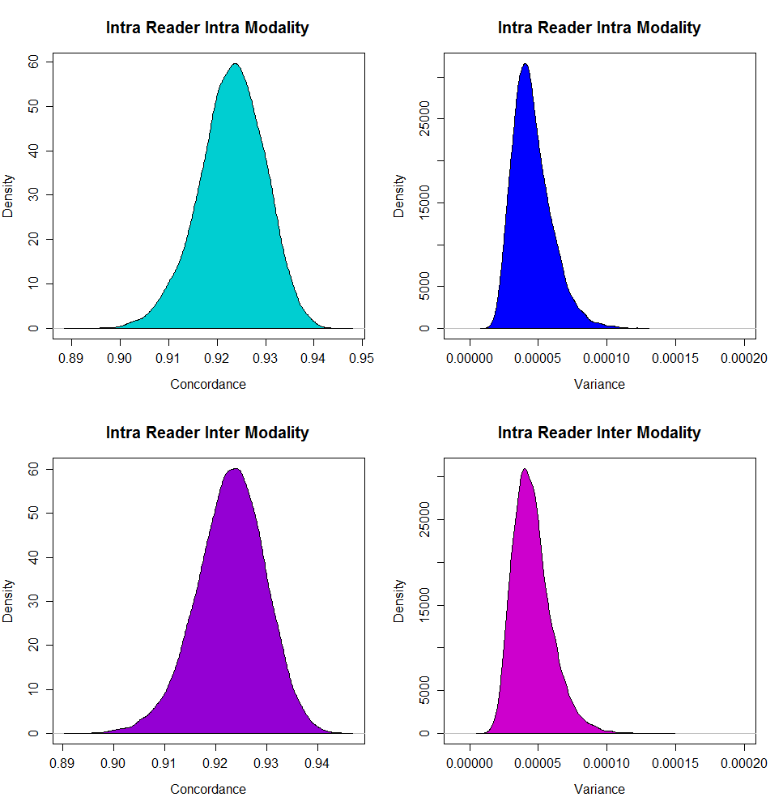
Intra-Reader Agreement - Fully Crossed
Readers = 12 Cases = 120 MC Trials = 10,000 |  | Intra Modality | Inter Modality
Concordance | Mean | 0.9230058 | 0.807092
 | Variance | 0.0000459 | 0.0000454
Variance Estimates | Mean | 0.0000457 | 0.0000458
 | Variance | 2.069e-10 | 2.037e-10

Slide 23
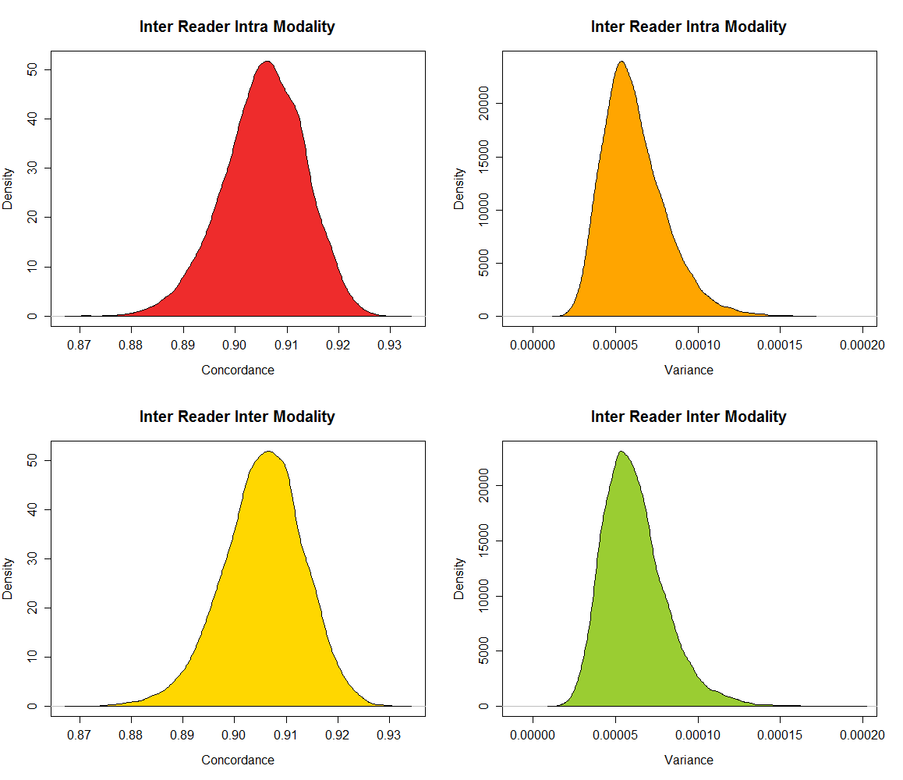
Inter-Reader Agreement - Fully Crossed
Readers = 12 Cases = 120 MC Trials = 10,000 |  | Intra Modality | Inter Modality
Concordance | Mean | 0.9055458 | 0.9054926
 | Variance | 0.0000620 | 0.0000614
Variance Estimates | Mean | 0.0000617 | 0.0000617
 | Variance | 3.676e-10 | 3.658e-10

Slide 24
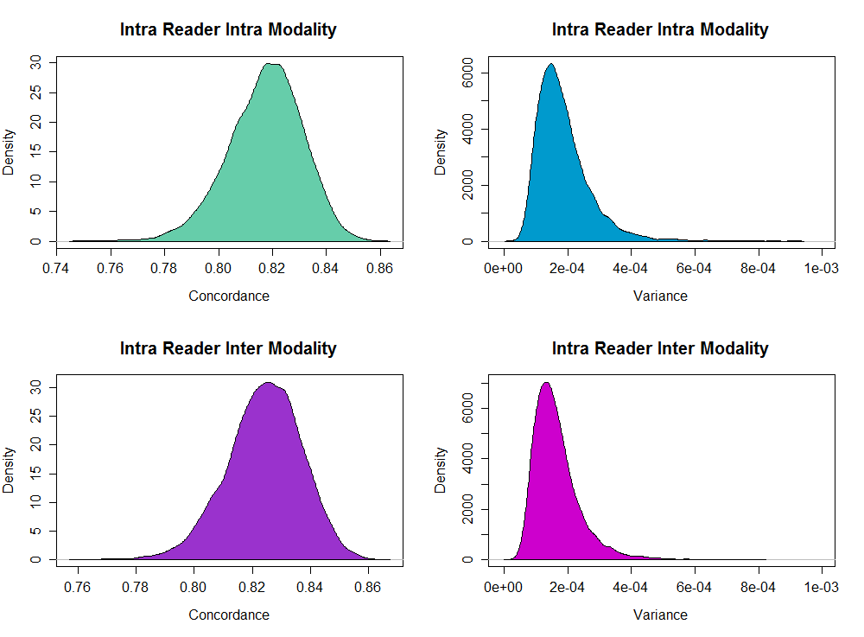
Intra-Reader Agreement - Split Plot
Readers = 12 Cases = 120 MC Trials = 10,000 |  | Intra Modality | Inter Modality
Concordance | Mean | 0.817427 | 0.824167
 | Variance | 0.000188 | 0.000166
Variance Estimates | Mean | 0.000185 | 0.000164
 | Variance | 6.74E-09 | 5.25E-09

Slide 25
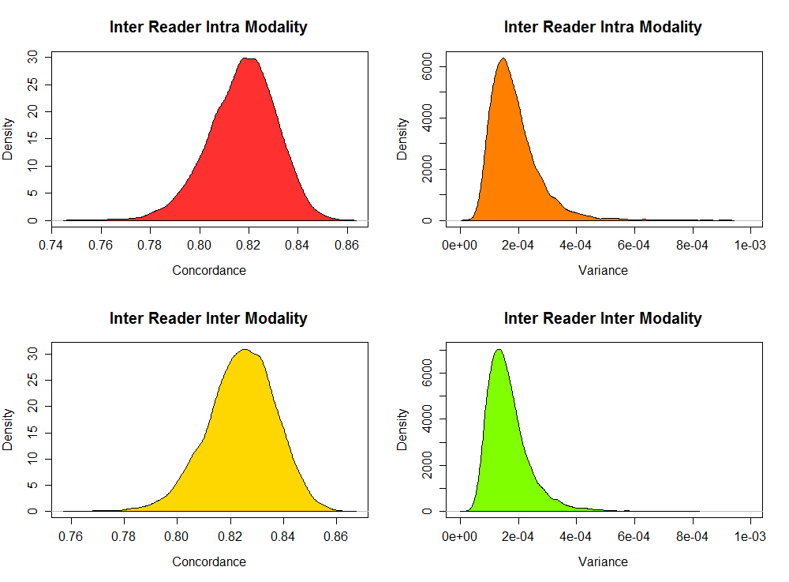
Inter-Reader Agreement - Split Plot
Readers = 12 Cases = 120 MC Trials = 10,000 |  | Intra Modality | Inter Modality
Concordance | Mean | 0.815621 | 0.807092
 | Variance | 0.000204 | 0.000175
Variance Estimates | Mean | 0.000199 | 0.000172
 | Variance | 3.27E-08 | 2.38E-08

Slide 26
Status and Future Work
Release R Package
Simulation
Agreement
Plots
NIH Study
Censored data impacts reader vs. truth agreement
Distribute the work at SPIE and Publish!

Slide 27
Acknowledgements
Brandon Gallas
Qi Gong
To-Oanh
Weijie Cheng
Zhiwei Zhang
Kyle J. Myers
Aldo Badano
Nicholas Petrick
Marios Gavrielides

Slide 28
Thank You

